Slide 1

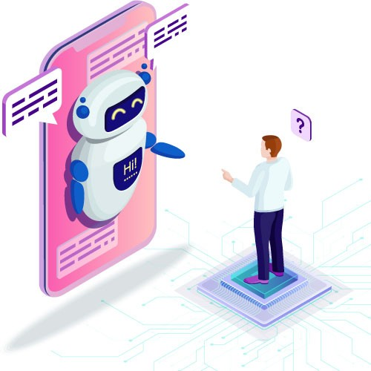


TEAM 7
Topic 2 : CHATBOT USING RASA FOR COVID

Slide 2
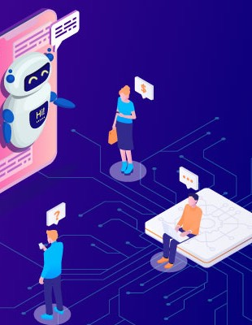
TEAM MEMBERS
SATHIYA NARAYANAN V
SATHISH KUMAR P
SANTHOSH P (BOT)

Slide 3
OVERALL VIEW
PROBLEM
Technology
To create a chatbot for questions regarding the coronavirus. This will be based on artificial intelligence (AI) and natural language understanding (NLU).
The chatbot is created using rasa And Synthetic voice generation model to create voice of three persons.
Information
Training
The chatbot provides information about covid cases , Vaccination , Test Centers , symptoms and preventive measures.
The data used to train the module is from users.

Slide 4
# | Task | Owner | Start Date | End Date | Dependencies
1. | Training the chatbot with the input dataset And integration of API | Sathiya Narayanan | 3-10-21 | 4-10-21 | RASA, Python
2. | Integration of API | Santhosh | 5-10-21 | 5-10-21 | Python
3. | Designed a web page to access the model and integrating the bot | Sathish Kumar | 6-10-21 | 7-10-21 | Javascript,python
4. | Deploying the chatbot model in Cloud | Santhosh | 8-10-21 | 8-10-21 | AWS
5. | Testing the Chatbot | Sathiya Narayanan | 9-10-21 | 9-10-21 | Python
6. | Training the model with the Voice Dataset | Santhosh | 10-10-21 | 11-10-21 | Sythetic Voice Generation model
7. | Experimenting the Voice-bot in the webpage in different voices. | Sathish Kumar | 12-10-21 | 13-10-21 | Flask

Slide 5
Risks & Mitigation / Action plan
# | Risk | Severity | Probability | Mitigation / Action Plan
1. | Wrong Interpretation and Poor time estimates | High | Low | Improving the Training Data Set with high Quality examples and stories
2. | Maintenance | Medium | Low | Assigned a co-leader to take charge in the absence of leader in the time of unanticipated events

Slide 6


